Slide 1
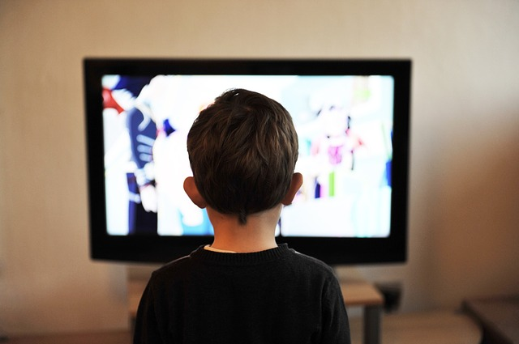
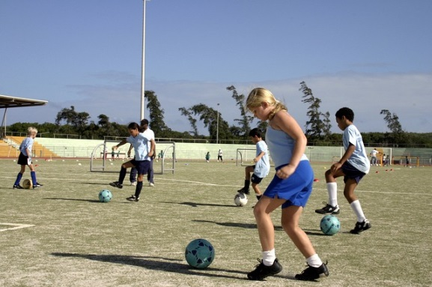
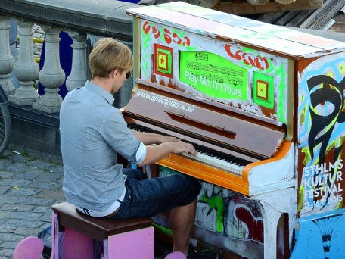
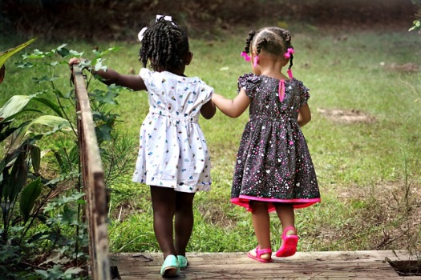
HOBBIES

Slide 2
READING BOOKS

Slide 3
PLAYING COMPUTER GAMES

Slide 4
PLAYING OUTSIDE WITH FRIENDS

Slide 5
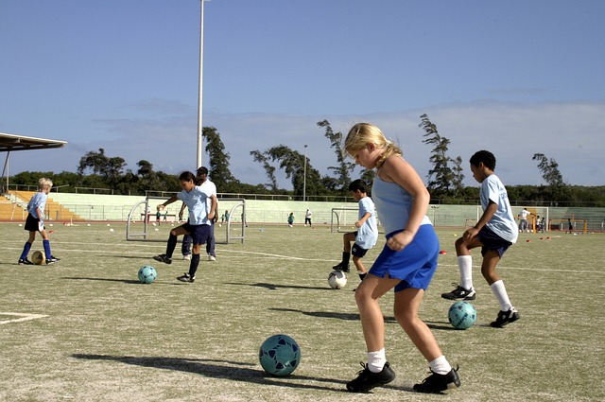
PLAYING FOOTBALL

Slide 6
PLAYING THE PIANO

Slide 7
WATCHING FILMS

Slide 8
Mulle meeldib- I LIKE
Ma naudin- I ENJOY
Ma olen kiindunud- I’M FOND OF
Ma olen hea milleski- I’M GOOD AT

Slide 9
TÕLGI
Mulle meeldib lugeda.
I like reading books.
Ma naudin sõpradega õues mängimist.
I enjoy playing outside with friends.
Ma olen kiindunud muusikasse.
I’m fond of music.
Ma olen hea jalgpalli mängimises.
I’m good at playing football.

Slide 10
EXTRA
WHAT DO YOU LIKE DOING?

