Slide 1
Unit 1
Introductions

Slide 2
Greetings
Good morning/Good afternoon/Good evening
HeIlo/Hi
How are you?
I’m fine/good thanks, and you?
Nice to meet you/ pleased to meet you.

Slide 3
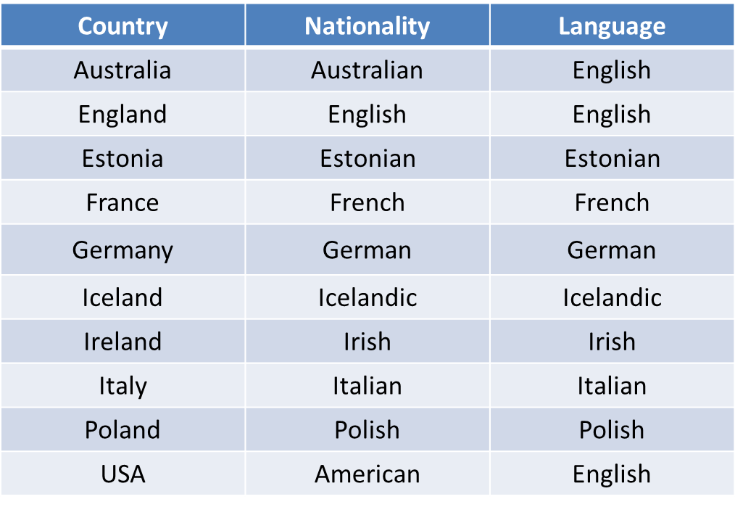
Where are you from?

Slide 4
Where are you from?
I am from Australia. I am Australian
She is from England. She is English.
They are from Poland. They are Polish.

Slide 5
Verb ‘to be’
I ___ Irish
You are Irish
He/she/it ____ Irish
You (plural) are Irish
We are Irish
They ____ Irish

