Slide 1
WAS/ WERE Past Simple
Ingrid Lilles
Paikuse Pk

Slide 2
WAS, WERE
Was ja were on sõna „olema“ vormid minevikus.
last year last week now
last month yesterday

Slide 3
WAS
MINA OLIN
TEMA OLI
SEE OLI
I WAS
HE WAS
SHE WAS
IT WAS

Slide 4
WERE
SINA OLID
MEIE OLIME
TEIE OLITE
NAD OLID
YOU WERE
WE WERE
YOU WERE
THEY WERE

Slide 5
WAS
It was sunny yesterday.
Eile oli päikesepaisteline ilm.

Slide 6
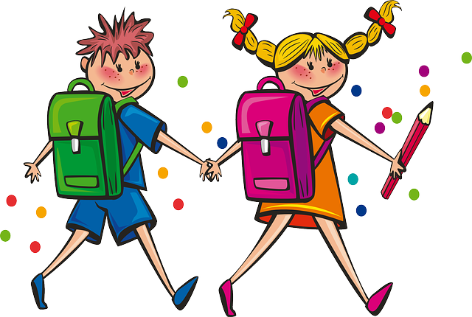
WAS
We were at school yesterday.
Me olime eile koolis.

Slide 7
COMPARE (võrdle)
PRESENT TENSE (olevik)
I AM HAPPY.
YOU ARE SAD.
SHE IS ILL.
THE CAR IS NEW.
WE ARE ANGRY.
THEY ARE VERY POLITE.
PAST TENSE (minevik)
I WAS HAPPY.
YOU WERE SAD.
SHE WAS ILL.
THE CAR WAS NEW.
WE WERE ANGRY.
THEY WERE VERY POLITE.

Slide 8
EITUS
PIKK VORM
LÜHIVORM
I WAS NOT
YOU WERE NOT
HE WAS NOT
SHE WAS NOT
IT WAS NOT
WE WERE NOT
THEY WERE NOT
I WASN’T
YOU WEREN’T
HE WASN’T
SHE WASN’T
IT WASN’T
WE WEREN’T
THEY WEREN’T

Slide 9
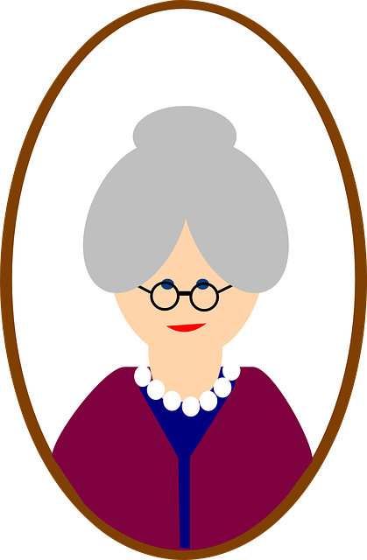
TRANSLATE
Minu vanaema ei olnud õpetaja, ta oli arst.
My granny wasn’t a teacher, she was a doctor.

Slide 10
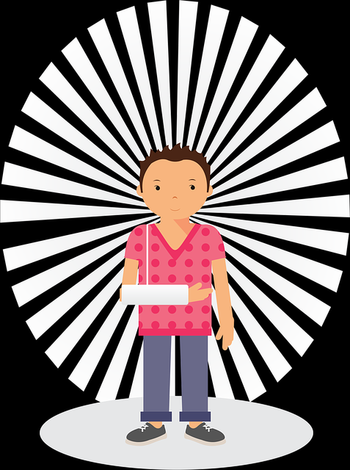
TRANSLATE
Ma ei olnud eile koolis, sest ma olin haige.
I wasn’t at school yesterday because I was ill.

Slide 11
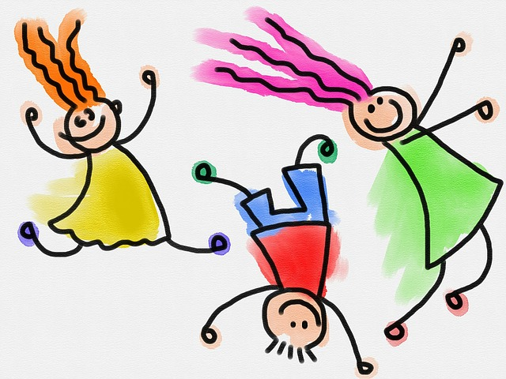
TRANSLATE
Me ei olnud õnnetud, me olime rõõmsad.
We weren’t sad, we were happy.

Slide 12
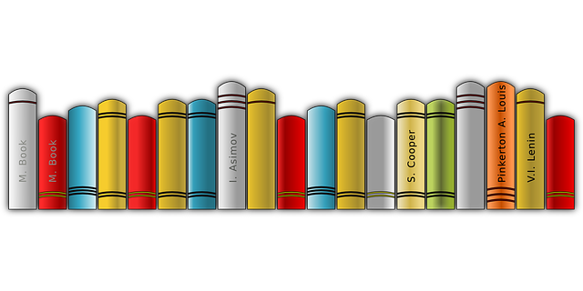
TRANSLATE
Raamatud ei olnud laual, need olid riiulil.
The books weren’t on the table, they were on the shelf.

Slide 13
QUESTIONS
KAS MA OLIN?
KAS SA OLID?
KAS TA OLI?
KAS SEE OLI?
KAS ME OLIME?
KAS TE OLITE?
KAS NAD OLID?
WAS I?
WERE YOU?
WAS HE?
WAS SHE?
WAS IT?
WERE WE?
WERE YOU?
WERE THEY?

Slide 14
ANSWERS
YES, | I/ he/ she/ it was. you/ we/ they were.
NO, | I/ he/ she/ it wasn’t. you/ we/ they weren’t.

Slide 15
WAS OR WERE?
Find the missing word.
............. you at the party yesterday?
............. your mother at work yesterday?
............. your friends at school yesterday?
............. the weather good yesterday?
............. Your friends happy yesterday?
Answer the questions.

Slide 16
ANSWERS
Were you at the party yesterday?
Was your mother at work yesterday?
Were your friends at school yesterday?
Was the weather good yesterday?
Were your friends happy yesterday?

