Slide 1
WEATHER
Class 4

Slide 2
WINDY
TUULINE

Slide 3
FROSTY
PAKASELINE, KÜLM

Slide 4
SUNNY
PÄIKESEPAISTELINE

Slide 5
CLOUDY
PILVINE

Slide 6
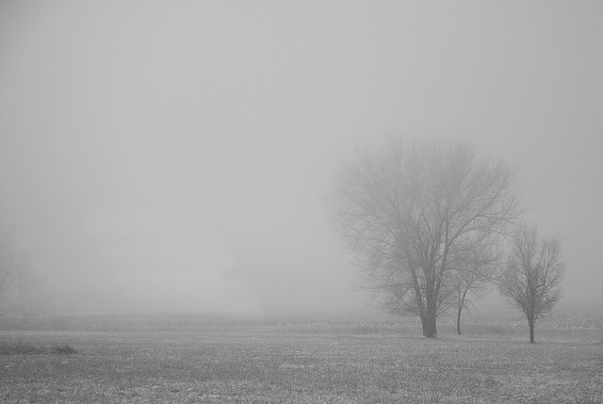
FOGGY
UDUNE

Slide 7
RAINY
VIHMANE

Slide 8
SNOWY
LUMINE

Slide 9
MIS ILM TÄNA ON?
WHAT’S THE WEATHER LIKE TODAY?
IT’S .............

Slide 10
What’s the weather like today?
It’s FROSTY.

Slide 11
What’s the weather like today?
It’s WINDY.

Slide 12
What’s the weather like today?
It’s SUNNY.

Slide 13
What’s the weather like today?
It’s CLOUDY.

Slide 14
What’s the weather like today?
It’s FOGGY.

Slide 15
What’s the weather like today?
It’s SNOWY.

Slide 16
What’s the weather like today?
It’s RAINY.

Slide 17
EXTRA
Look out of the window!
What’s the weather like today?
Is it sunny? Is it foggy? Make three sentences.

