Slide 1
ZOO ANIMALS
Ingrid Lilles
Paikuse PK

Slide 2
HIPPO

Slide 3
EXTRA
Colour me!
http://www.anglomaniacy.pl/hippoA.htm

Slide 4
KANGAROO

Slide 5
TIGER

Slide 6
EXTRA
Dress me up!
http://www.anglomaniacy.pl/tigerA.htm

Slide 7
LION

Slide 8
PENGUIN

Slide 9
ELEPHANT

Slide 10
EXTRA
More about elephants.
Http://www.anglomaniacy.pl/elephant.htm

Slide 11
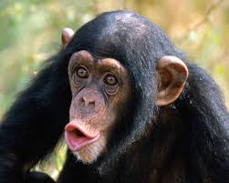
MONKEY

Slide 12
ZEBRA

Slide 13
GIRAFFE

Slide 14
EXTRA
More about giraffes.
http://www.anglomaniacy.pl/giraffe.htm

Slide 15
SING A SONG

